Slide 1
STAT 411 Final Project: Breast Cancer Prediction
By Bohan Wu, Marcus Martinez, and Paul Gao

Slide 2
Introduction
Predictive Analysis of Breast Cancer Data
Comparison of Frequentist and Bayesian Linear Regression Methods
Intuitive, Statistical and Model Based Model Selection
Comparison of priors and MCMC methods
Bayesian model inference
Frequentist and Bayesian Model Average predictive comparison
Overall goal is to predict the mean radius size of a cancerous cell
MSE and MAPE

Slide 3
Background/Motivation
Interest in Medical Statistics
Personal Reasons

Slide 4
Data
Descriptive Data on Cancerous Cells from 3-D Imaging
University of Wisconsin
569 observations with 31 variables
All measurements are in micrometers

Slide 5
Model Selection
Intuitive
Removed parameter, area, etc.
Statistical
Used stepwise AIC/BIC and VIF scores
Model Based Model Selection
We ran both Ridge and Lasso Regressions
Final Model
Fractal Dimension Mean, Smoothness Mean, Compactness Mean Concavity Mean, Texture SE, Smoothness SE, Concave Point SE , and Malignant or Benign Factor

Slide 6
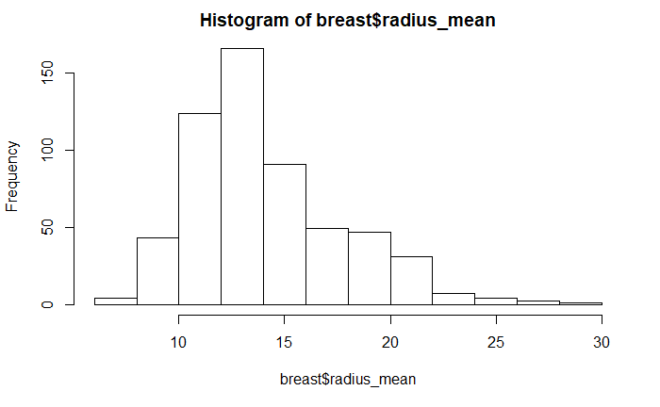
Response Data

Slide 7

Frequentist Linear Regression Methods
MLR
Ridge
Lasso
$y_{i}=X_{i}β+ε_{i}$ where $ε_{i}\sim N(0, σ^{2})$

Slide 8
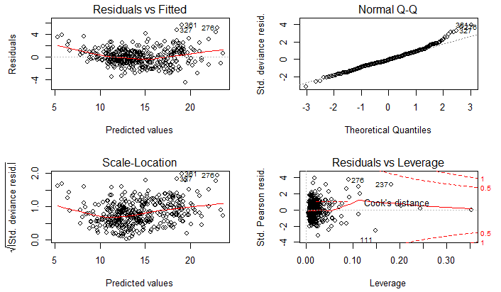
Multilinear Regression: Gaussian
Family = Gaussian
MSE = 2.352
MAPE = .081
AIC = 1413

Slide 9
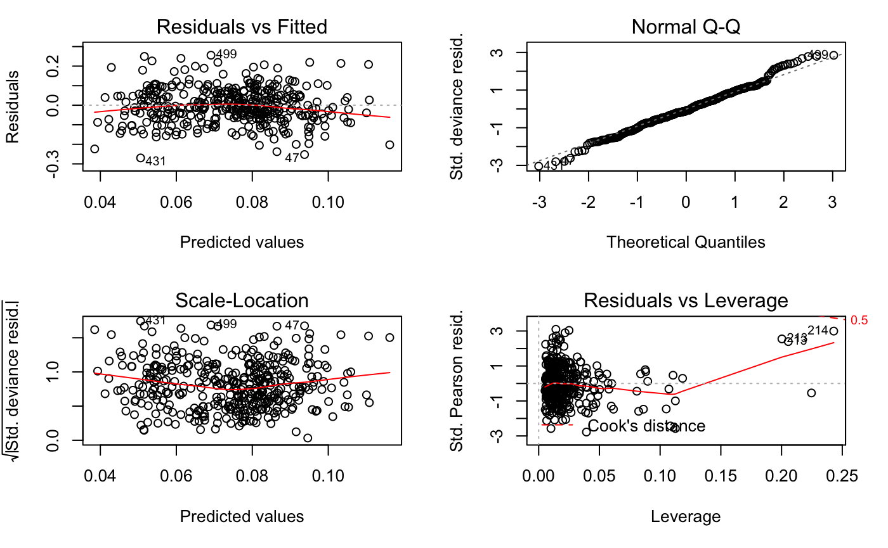

Multilinear Regression: Gamma
Family = Gamma
MSE = 2.417
MAPE = 0.075
AIC = 1309. 5
Gamma regression fits slightly better
For the sake of computation ease, we a$ssume ε_{i}$ are i.i.d normal

Slide 10
Ridge and Lasso Regression
Ridge
MSE = 2.354
MAPE = .081
Lasso
MSE = 2.362
MAPE = .081
Lasso and Ridge results are quite similar to MLR in our case.

Slide 11
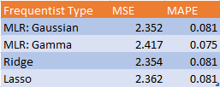
Frequentist Results
All types have the same MAPE
MLR has the lowest MSE and best results

Slide 12
Bayesian Linear Regression Comparisons
3 Different MCMC Methods: Gibbs Sampler, Independent Metropolis Hastings(IMH), Hamiltonian MC
4 Different Priors: noninformative prior(Jeffrey prior), semi conjugate prior, g-prior, conjugate prior
Inference on Specific Models (2 best priors, 2 best mcmc)
Posterior Distribution of Parameters.
Credible Intervals.
Bayesian Model Average for Prediction

Slide 13
Comparison of MCMC methods
Recall 3 methods of interest
Gibbs sampler
Hamiltonian MC
Independent Metropolis Hastings(IMH)

Slide 14
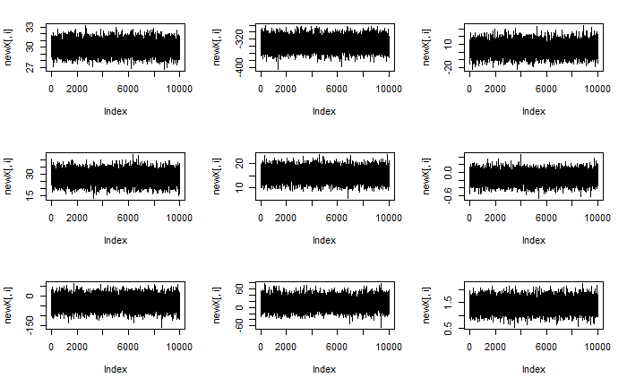
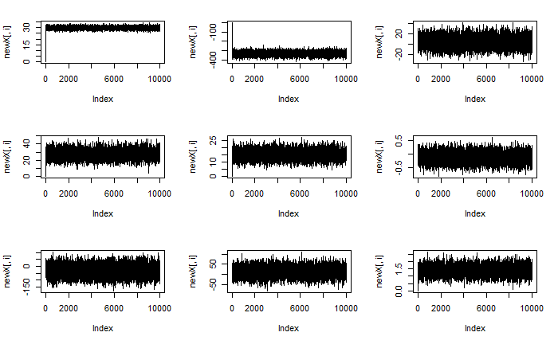
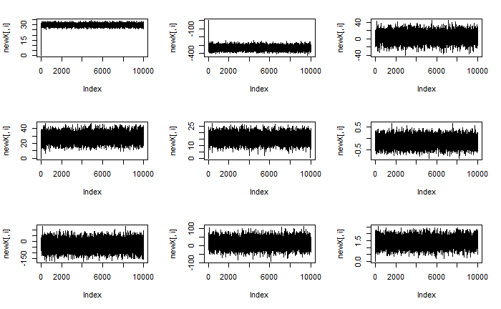
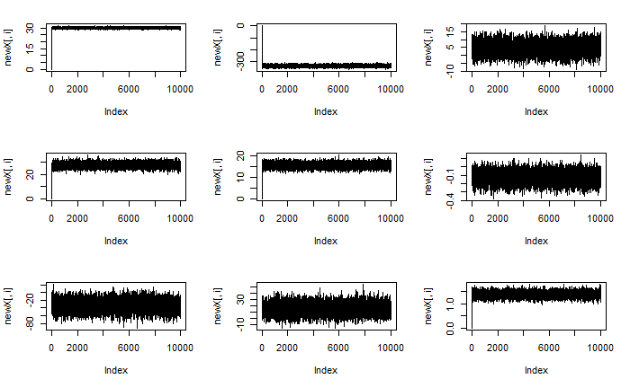

Gibbs Sampler
Top to bottom: Jeffrey, Semi-conjugate, g , conjugate prior
Performs Equally well on all 4 priors.
Convergence plot: $β_{0}=0, σ_{0}^{2}=1$

Slide 15

Metropolis Hastings (Hamiltonian)
Perform better than IMH, however still susceptible to starting values $β_{0}, σ_{0}^{2}$
Acceptance Probability : Semi-conjugate > Jeffrey> Conjugate > g
Set $β_{0}=0, σ_{0}^{2}=1$for each prior
Prior: | Jeffrey | Semi-conjugate | Zellner’s g | Conjugate
Acceptance Probability | 0.2 | 0.9539 | 0.0041 | 0.0224

Slide 16

Metropolis Hastings (Independent)
3 key components: $β_{0}, σ_{0}^{2}$, proposal distribution
In this case, IMH perform worse than HMC and Gibbs because:
Hard to pick good $β_{0}, σ_{0}^{2}$
hard to pick a good proposal distribution for $β_{(t)}$, which is an $9×1$ vector.
$β_{(t)}$and $σ_{(t)}^{2}$not necessarily independent
However, useful when our parameter is 1-dimensional.

Slide 17
Comparison of Priors
Non-Informative
Semi-Conjugate
Zellner’s G
Conjugate

Slide 18
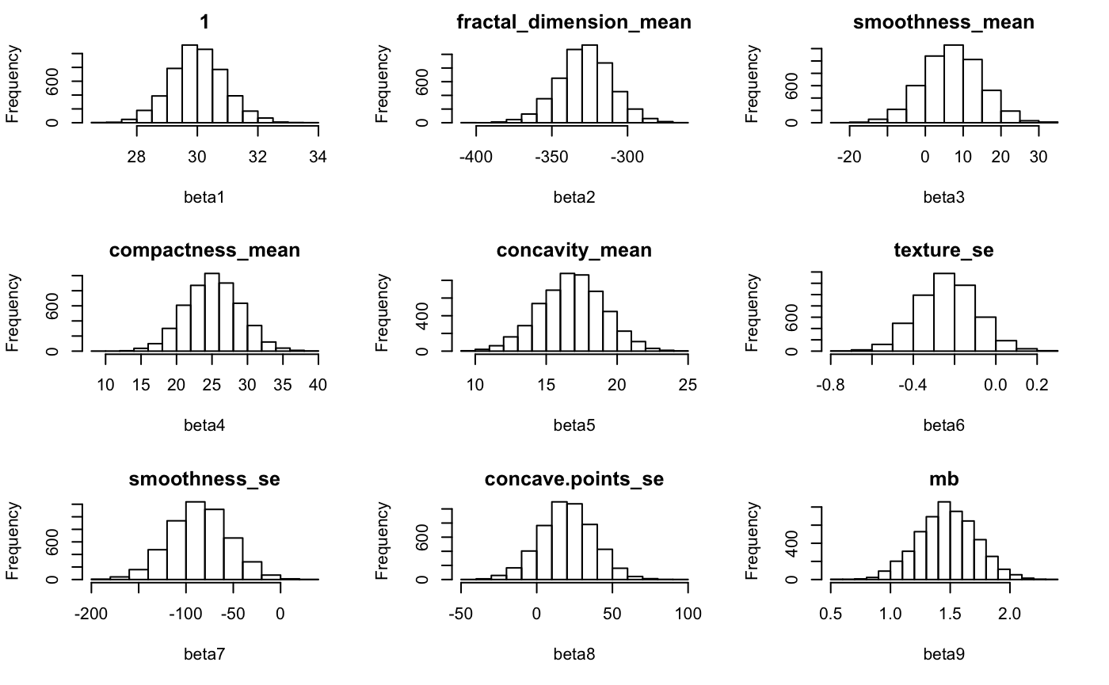
Non Informative
Posterior distribution of each beta, simulated using Gibbs sampling.
Question: how do we compare different priors in a given mcmc setting?
Idea: for each beta, the prior that has the least “spread out “ posterior distribution -> compare variance

Slide 19
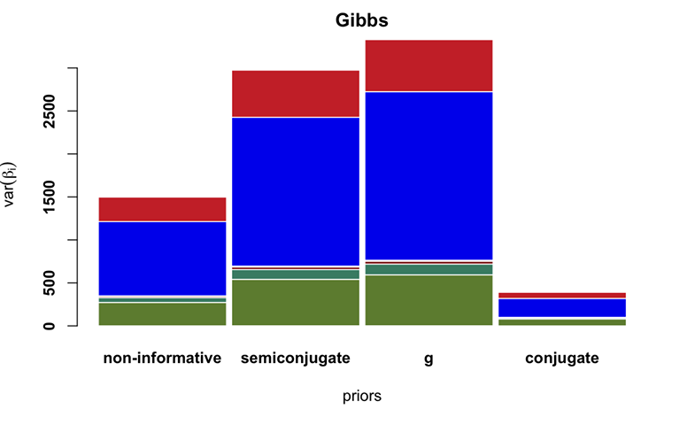
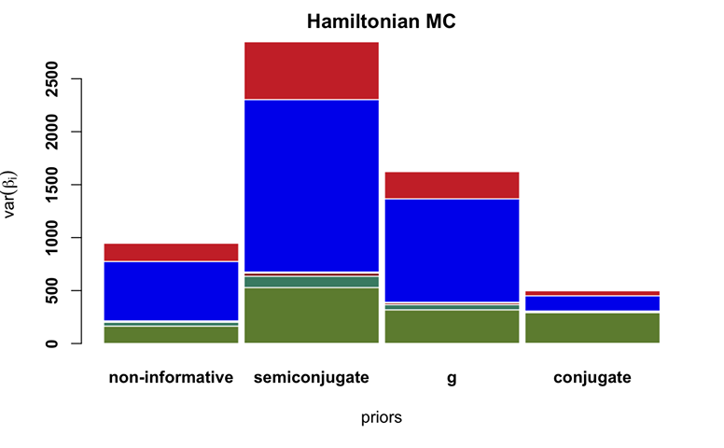

Posterior Variance Comparison
Each color represents a different $β_{j}$.

Slide 20

Inference Overview
Posterior Distribution of $β_{j}$
Bandwidth to check top/bottom 2 most informative $β_{j}$
Credible Intervals
Model Checking and Robustness

Slide 21
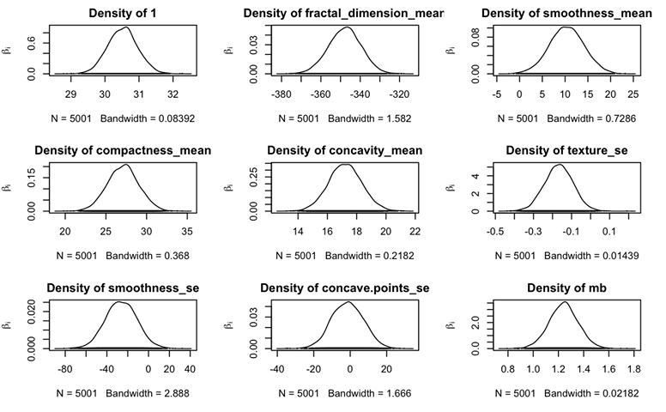
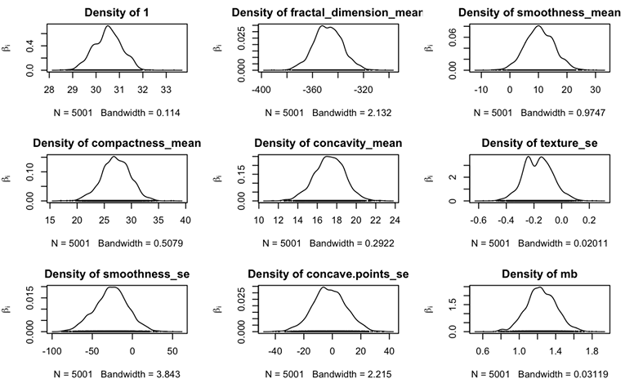

Posterior Distribution of $β$
Gibbs + Conjugate
HMC + Jeffrey

Slide 22

Most and Least “Informative” $β_{j}$ Based on Mean Absolute Percent Deviation (MAPD)*
Gibbs + Conjugate
Most
Fractal Dimension Mean**= .019
Least
Concave Points_SE= 4.799
HMC +Jeffrey
Most
Fractal Dimension Mean = .026
Least
Concave Points_SE = 4.593
*Aside from the Intercept term
**: Fractal Dimension measures abnormality of biopsy tissue. Concave Points_SE is standard error of # of concave portion on a tissue

Slide 23
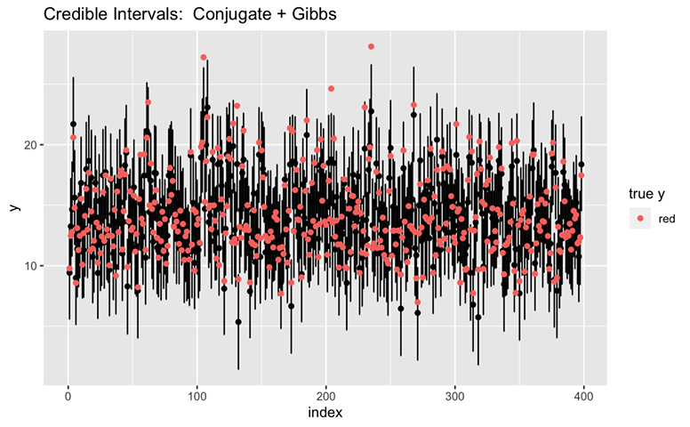
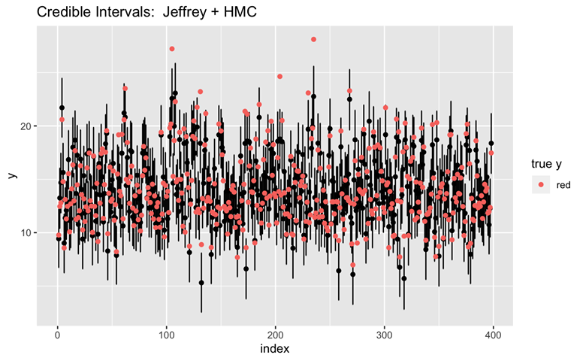

Model Checking and Robustness
Check the position of true y relative to the 95% CI of simulated results $\hat{y}$
Capture Rate = 98.2421%
Capture Rate = 95.22613%
$$β_{j}^{}$$

Slide 24
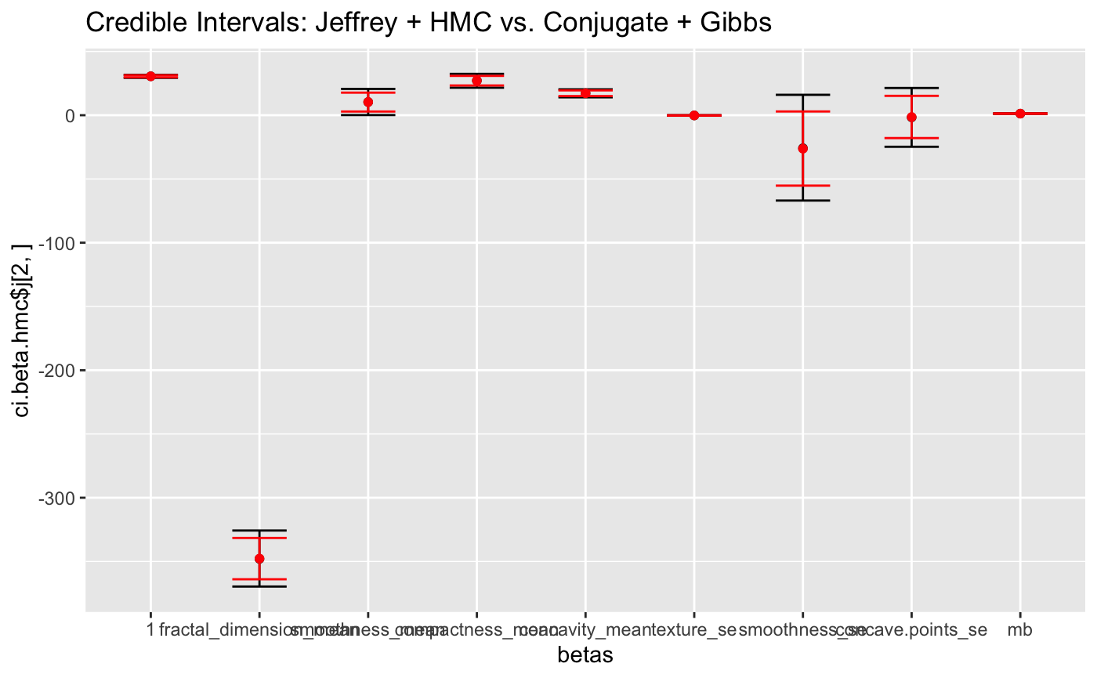
Credible Intervals
Dark: Jeffrey + HMC
Red: Conjugate + Gibbs

Slide 25

Prediction
Posterior predictive distribution : first draw the $(β, {σ }^{2}$) from the joining posterior distribution, then draw $\hat{y} \sim N(\hat{X}β, σ^{2} I)$
Bayesian Model Average (BMA) results
Final Results: compare with Frequentist methods.
Overall “Best” Method

Slide 26
BMA Results
Gibbs + Conjugate
MSE = 2.122
MAPE = .078
HMC + Jeffrey
MSE = 2.120
MAPE = .078

Slide 27

Final Results
Prediction: Bayesian > Frequentist
Inference: Bayesian > Frequentist.
Bayesian has more inference tools
Flexibility: Bayesian > Frequentist
Frequentists : strict assumptions on $β, σ^{2}$(must be Gaussian, Gamma, etc)
Bayesian: Many available priors, can be approximated using MCMC.

Slide 28
Overall “Best” Method
In terms of prediction, the overall best model would be Hamiltonian MCMC with a Jeffrey’s Prior
MSE = 2.12
MAPE = .078
Other metrics
More informative: Conjugate Prior + Gibbs Sampler, lower posterior variance
Ease to implement: MLR Gaussian
Least Computational Intense (Bayesian): Jeffrey Prior + Gibbs Sampler

Slide 29
Questions?

